Slide 1



Hibernate Caching-Part 1
Chapter 41

Slide 2
Today’s Agenda
Hibernate Caching-Part 1
Introduction
What Is Caching ?
Types Of Cache
First Level Cache
Removing Objects From Cache

Slide 3
Introduction
While working with Hibernate a major issue is it’s slow speed which results into performance degradation.
This is because while interacting with the database , hibernate issues many queries.

Slide 4
Introduction
So more number of queries , means more database traffic and thus a slowdown in the speed of application.
So some techniques are necessary to maintain its performance.
Hibernate Caching is the best technique to solve this problem.

Slide 5
What Is Caching ?
Caching is nothing but some buffer where a record is stored when first time retrieved from the database.
When second time the same record is needed , Hibernate does not access the database and instead reads from the cache.

Slide 6
What Is Caching ?
This type of adjustment , decreases the database hits.
Accessing cache is much faster than accessing the database.

Slide 7
Types Of Caching
Hibernate comes with two types of cache mechanism:
First-level cache (or Session Cache) and
Second-level cache(or Session Factory Cache)

Slide 8
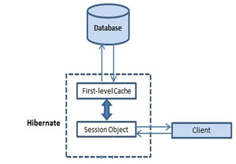
First Level Cache
First-level cache is associated with Session object.

Slide 9
First Level Cache
By default, for each hibernate application, the first level cache is automatically enabled
As a programmer, we do not have to enable the first level cache and also we cannot disable this first level cache

Slide 10
First Level Cache
The first level cache is associated with the session object and scope of the cache is limited to one session only
When we load an object for the first time from the database then the object will be loaded from the database and the loaded object will be stored in the cache memory maintained by that session object

Slide 11
First Level Cache
If we load the same object once again, with in the same session, then the object will be loaded from the local cache memory not from the database
If we load the same object by opening other session then again the object will load from the database and the loaded object will be stored in the cache memory maintained by this new session

Slide 12
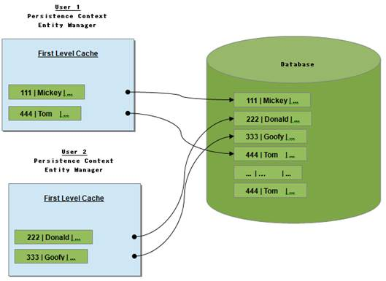
First Level Cache

Slide 13
Example 1
Session sess=sf.openSession();
System.out.println("Calling get first time");
Employee e=(Employee)sess.get(Employee.class, 1);
if(e!=null) {
System.out.println("EmpNo:"+e.getEmpNo());
System.out.println("EmpName:"+e.getEmpName());
System.out.println("EmpSal:"+e.getEmpSal());
System.out.println("Calling get second time!");
e=(Employee)sess.get(Employee.class, 1);
System.out.println("EmpNo:"+e.getEmpNo());
System.out.println("EmpName:"+e.getEmpName());
System.out.println("EmpSal:"+e.getEmpSal());
}
else
System.out.println("No recprd of employee found!");

Slide 14
Output
Calling get first time
Hibernate:
select
employee0_.emp_no as emp_no1_0_0_,
employee0_.emp_name as emp_name2_0_0_,
employee0_.emp_sal as emp_sal3_0_0_
from
Employee employee0_
where
employee0_.emp_no=?
EmpNo:1
EmpName:emp-1
EmpSal:1000.0
Calling get second time!
EmpNo:1
EmpName:emp-1
EmpSal:1000.0

Slide 15
Example 2
Session sess1=sf.openSession();
Session sess2=sf.openSession();
System.out.println("Calling get using session1");
Employee e=(Employee)sess1.get(Employee.class, 1);
if(e!=null) {
System.out.println("EmpNo:"+e.getEmpNo());
System.out.println("EmpName:"+e.getEmpName());
System.out.println("EmpSal:"+e.getEmpSal());
}
else
System.out.println("No recprd of employee found!");
System.out.println("Calling get using session2");
Employee f=(Employee)sess2.get(Employee.class, 1);
if(f!=null) {
System.out.println("EmpNo:"+f.getEmpNo());
System.out.println("EmpName:"+f.getEmpName());
System.out.println("EmpSal:"+f.getEmpSal());
}
else
System.out.println("No recprd of employee found!");
sess1.close();
sess2.close();
sf.close();

Slide 16
Output
Calling get using session1
Hibernate:
select
employee0_.emp_no as emp_no1_0_0_,
employee0_.emp_name as emp_name2_0_0_,
employee0_.emp_sal as emp_sal3_0_0_
from
Employee employee0_
where
employee0_.emp_no=?
EmpNo:1
EmpName:emp-1
EmpSal:1000.0
Calling get using session2
Hibernate:
select
employee0_.emp_no as emp_no1_0_0_,
employee0_.emp_name as emp_name2_0_0_,
employee0_.emp_sal as emp_sal3_0_0_
from
Employee employee0_
where
employee0_.emp_no=?
EmpNo:1
EmpName:emp-1
EmpSal:1000.0

Slide 17
Removing Objects From Cache
Though we can not disable the first level cache in Hibernate, but we can certainly remove some of objects from it when needed.
This is done using two methods :
evict()
clear()

Slide 18
Removing Objects From Cache
Here evict() is used to remove a particular object from cache associated with session, and clear() method is used to remove all cached objects associated with session.
So they are essentially like remove one and remove all.

Slide 19
Example 3
Session sess=sf.openSession();
System.out.println("Calling get first time");
Employee e=(Employee)sess.get(Employee.class, 1);
if(e!=null) {
System.out.println("EmpNo:"+e.getEmpNo());
System.out.println("EmpName:"+e.getEmpName());
System.out.println("EmpSal:"+e.getEmpSal());
System.out.println("Calling get second time!");
e=(Employee)sess.get(Employee.class, 1);
System.out.println("EmpNo:"+e.getEmpNo());
System.out.println("EmpName:"+e.getEmpName());
System.out.println("EmpSal:"+e.getEmpSal());
sess.evict(e);
System.out.println("Calling get third time!");
e=(Employee)sess.get(Employee.class, 1);
System.out.println("EmpNo:"+e.getEmpNo());
System.out.println("EmpName:"+e.getEmpName());
System.out.println("EmpSal:"+e.getEmpSal());
}
else
System.out.println("No recprd of employee found!");

Slide 20
Output
Calling get first time
Hibernate:
select
employee0_.emp_no as emp_no1_0_0_,
employee0_.emp_name as emp_name2_0_0_,
employee0_.emp_sal as emp_sal3_0_0_
from
Employee employee0_
where
employee0_.emp_no=?
EmpNo:1
EmpName:emp-1
EmpSal:1000.0
Calling get second time!
EmpNo:1
EmpName:emp-1
EmpSal:1000.0
Calling get third time!
Hibernate:
select
employee0_.emp_no as emp_no1_0_0_,
employee0_.emp_name as emp_name2_0_0_,
employee0_.emp_sal as emp_sal3_0_0_
from
Employee employee0_
where
employee0_.emp_no=?
EmpNo:1
EmpName:emp-1
EmpSal:1000.0

